Slide 1
The binomial distribution
I N T R O D U C T I O N TO STAT I ST I C S
George Boorman
Curriculum Manager, DataCamp

Slide 2
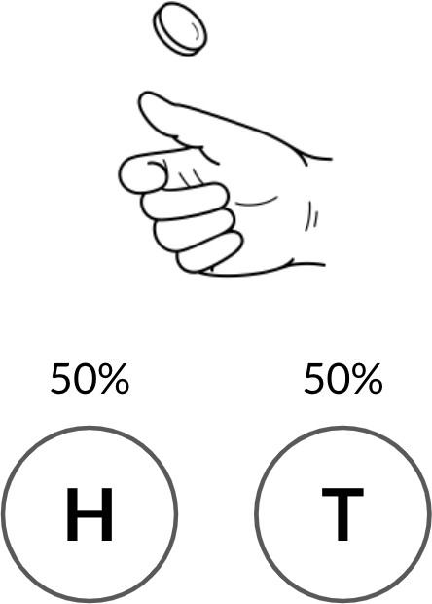
Coin flipping

Slide 3
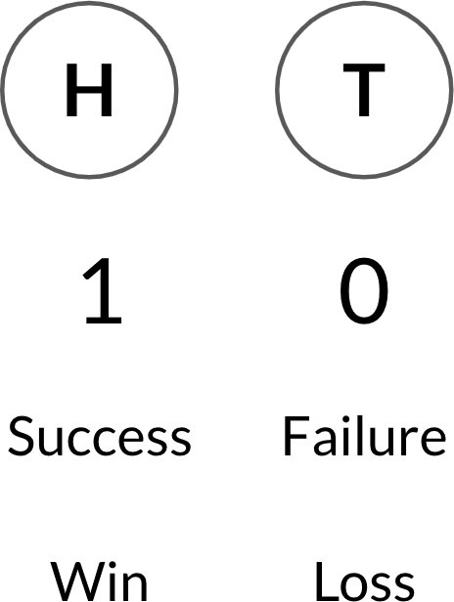
Binary outcomes

Slide 4
One coin flip many times
Coin Flip | Result
1 | 0
2 | 0
3 | 0
4 | 1
5 | 0
6 | 0
7 | 1
8 | 0
9 | 1
10 | 1

Slide 5
Binomial distribution
Probability distribution of the number of successes in a sequence of independent events
For example, the number of heads in a sequence of coin flips Described by n and p
n: total number of events
p: probability of success

Slide 6
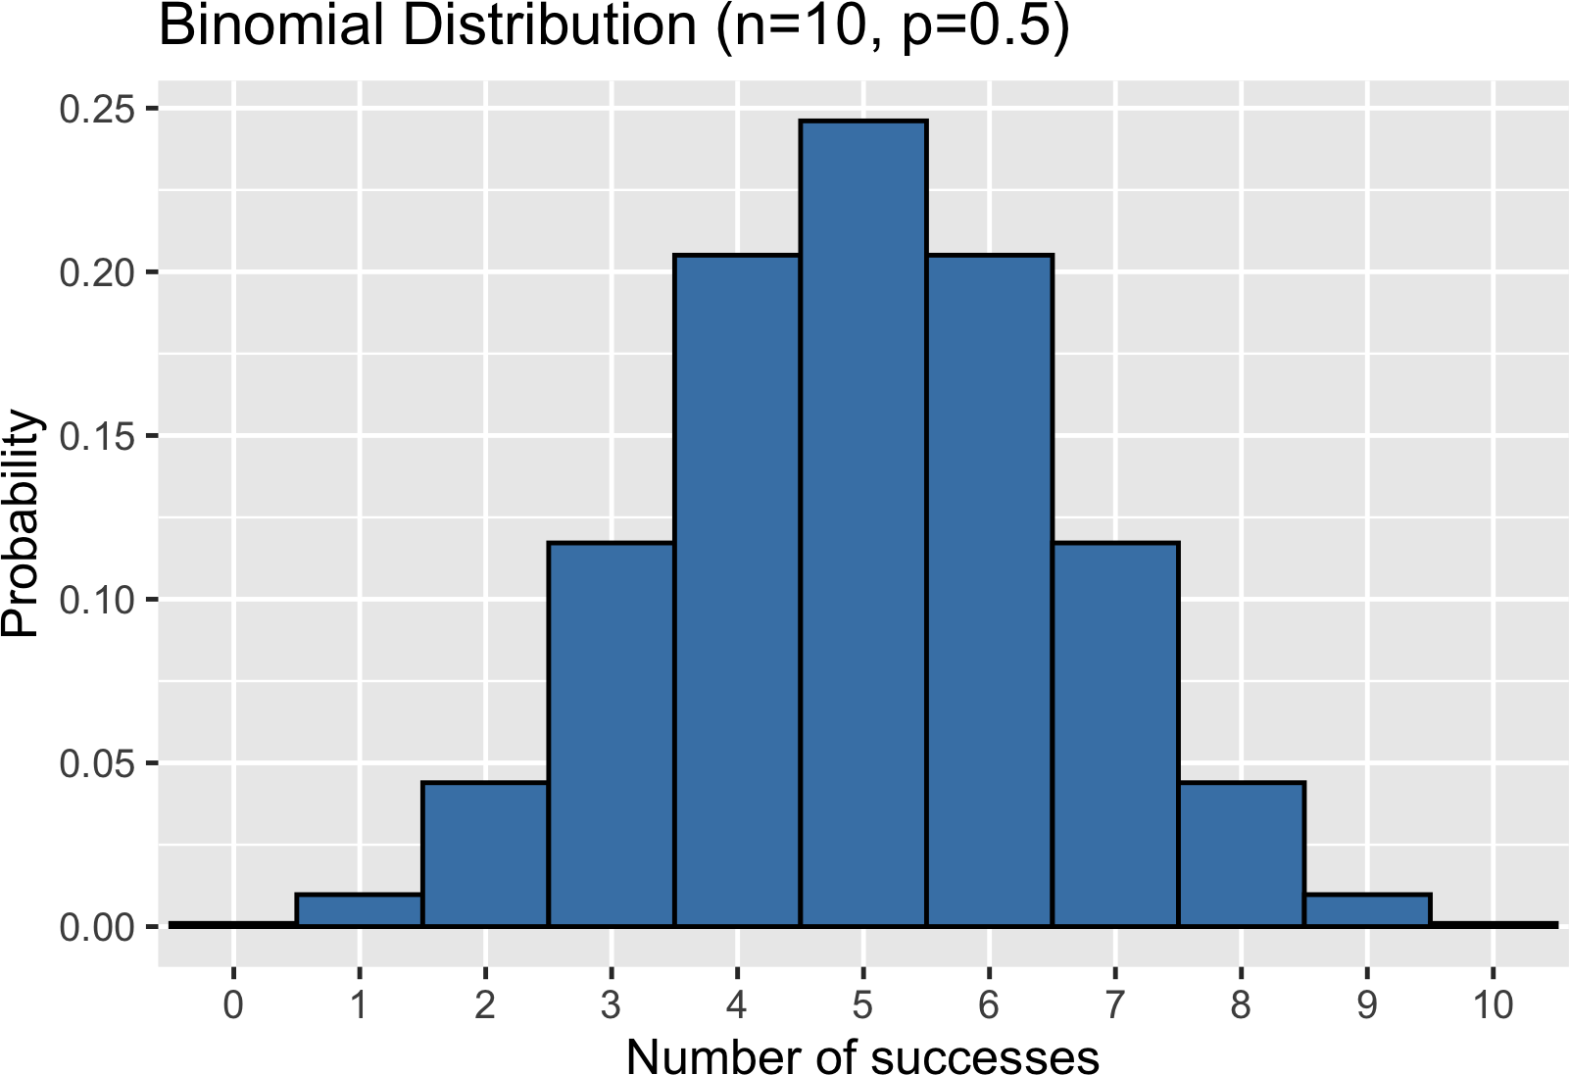
Binomial distribution

Slide 7
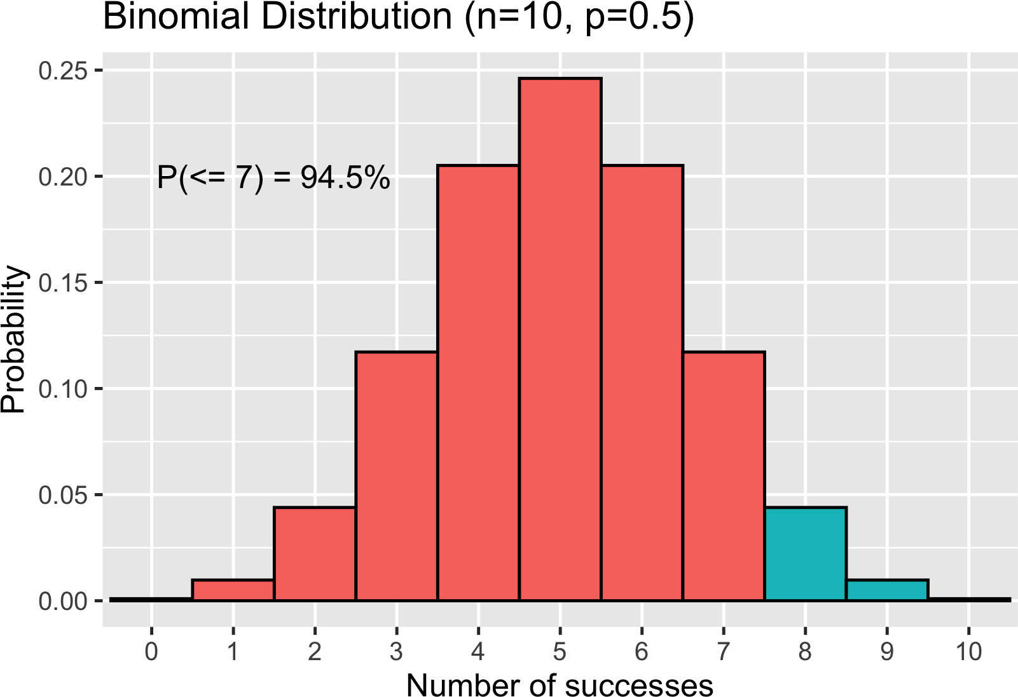
Probability of 7 or fewer heads

Slide 8
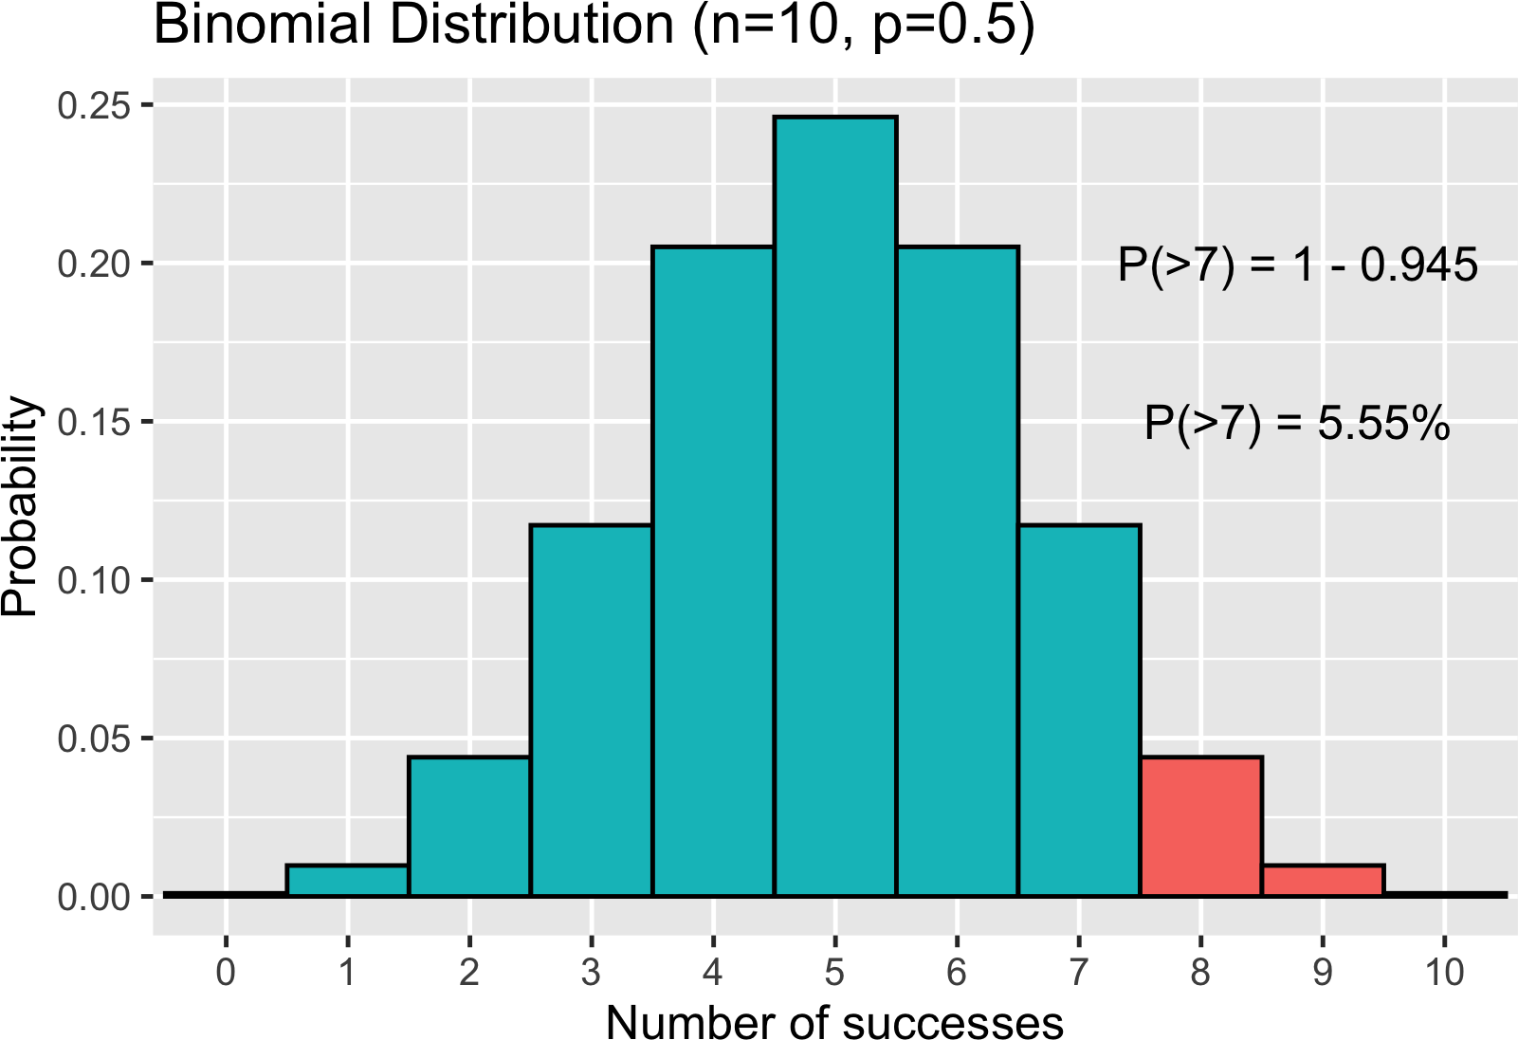
Probability of 8 or more heads

Slide 9
Expected value
Expected value = n × p
Expected number of heads out of 10 flips = 10 × 0.5 = 5
If we don't know p, but know n and the expected value:
_{p =} expected value
n

Slide 10
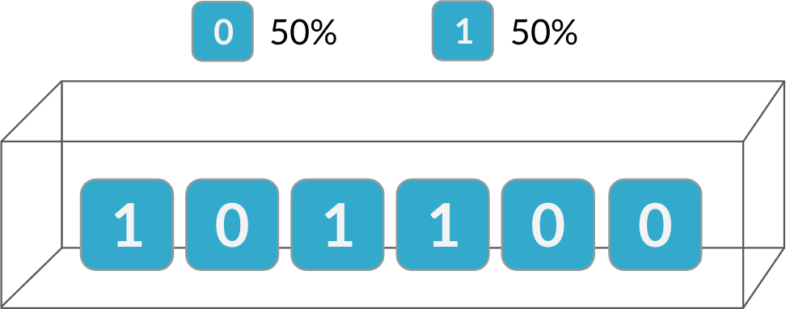
Independence
The binomial distribution is a probability distribution of the number of successes in a sequence of independent events

Slide 11
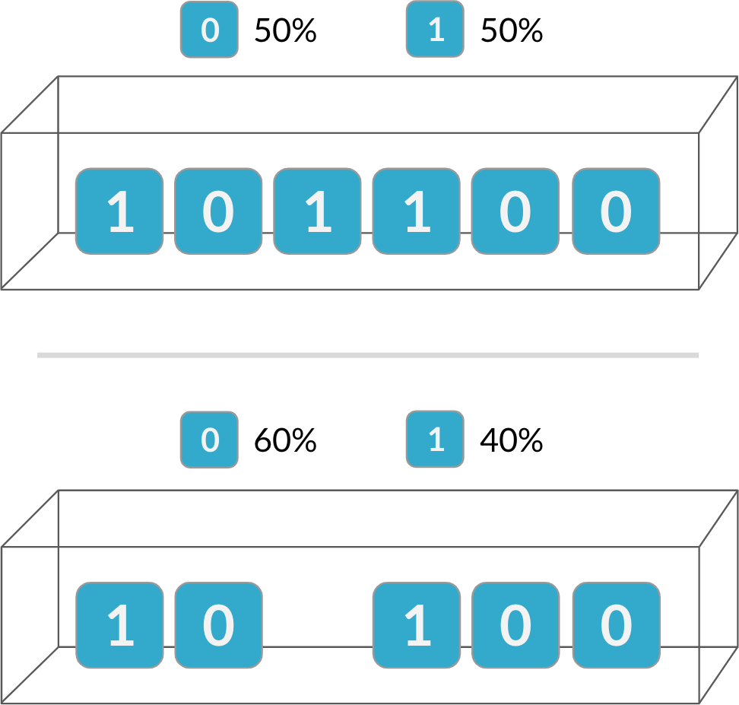
Independence
The binomial distribution is a probability distribution of the number of successes in a sequence of independent events
If events are not independent, the binomial distribution does not apply!

Slide 12

General applications
The binomial distribution can be used for independent events producing binary outcomes
Clinical trial measuring drug effectiveness Effective or not
Betting on the result of a sports match Bettor can win or lose
¹ Image credit: https://unsplash.com/@towfiqu999999

Slide 13
The normal distribution
I N T R O D U C T I O N TO STAT I ST I C S
George Boorman
Curriculum Manager, DataCamp

Slide 14
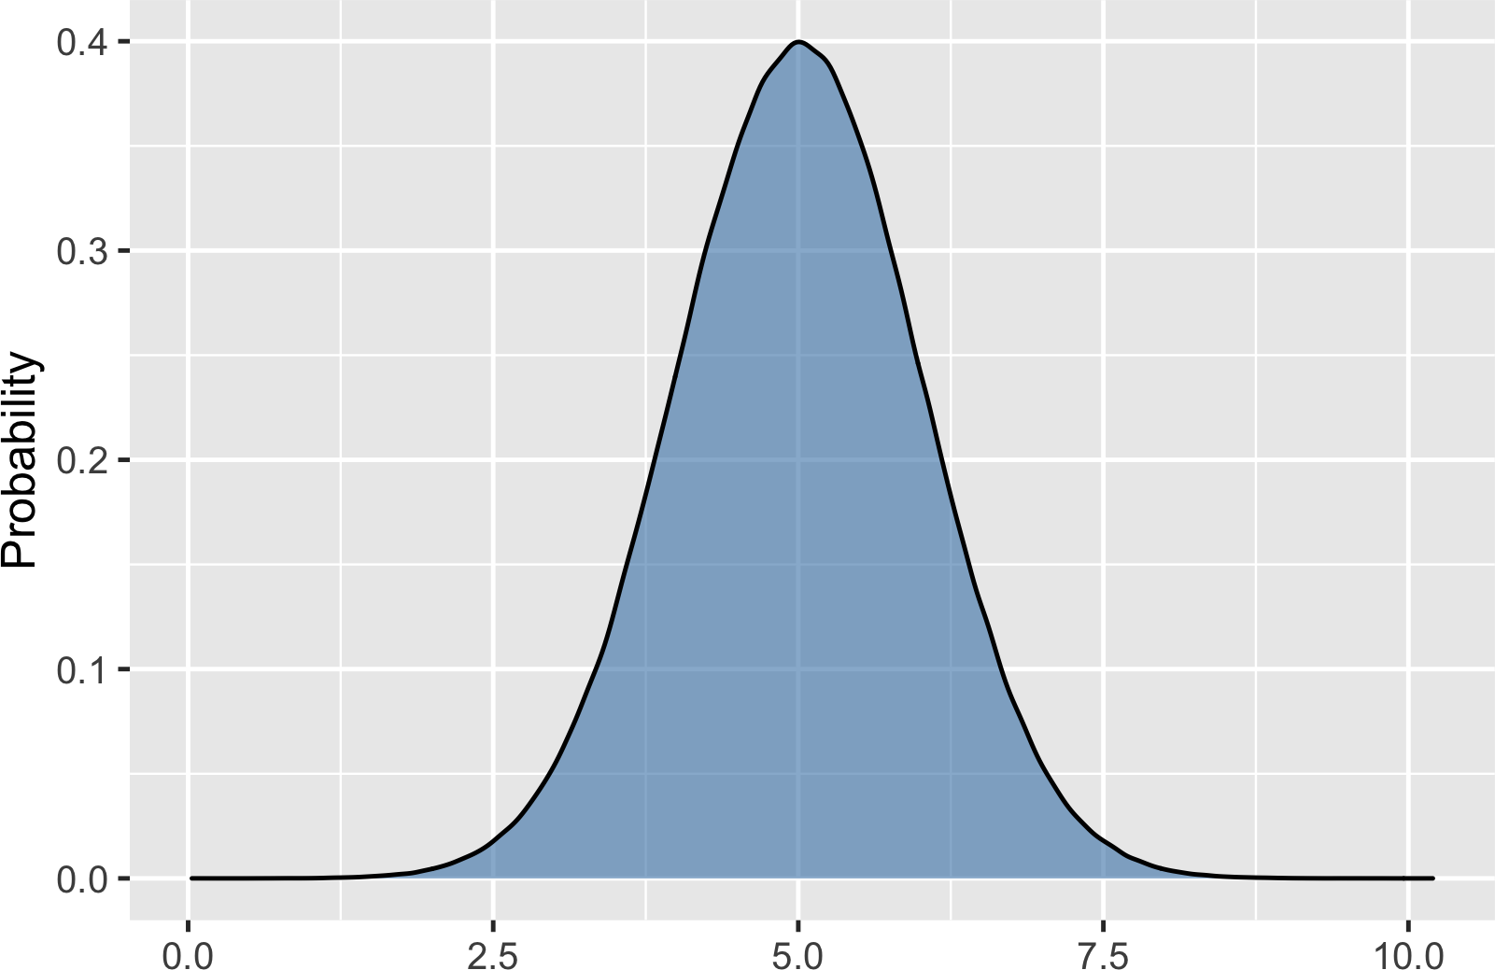
What is the normal distribution?

Slide 15
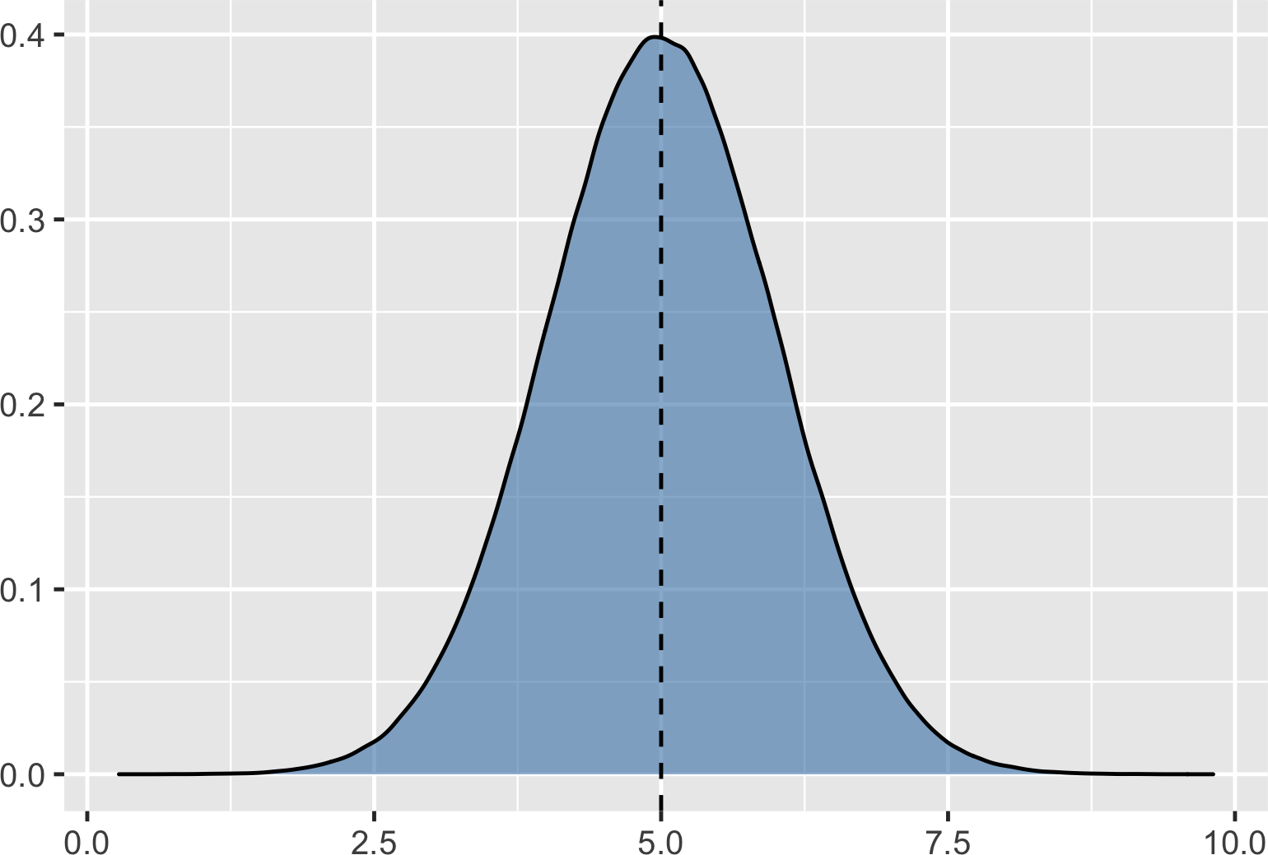
Symmetrical

Slide 16
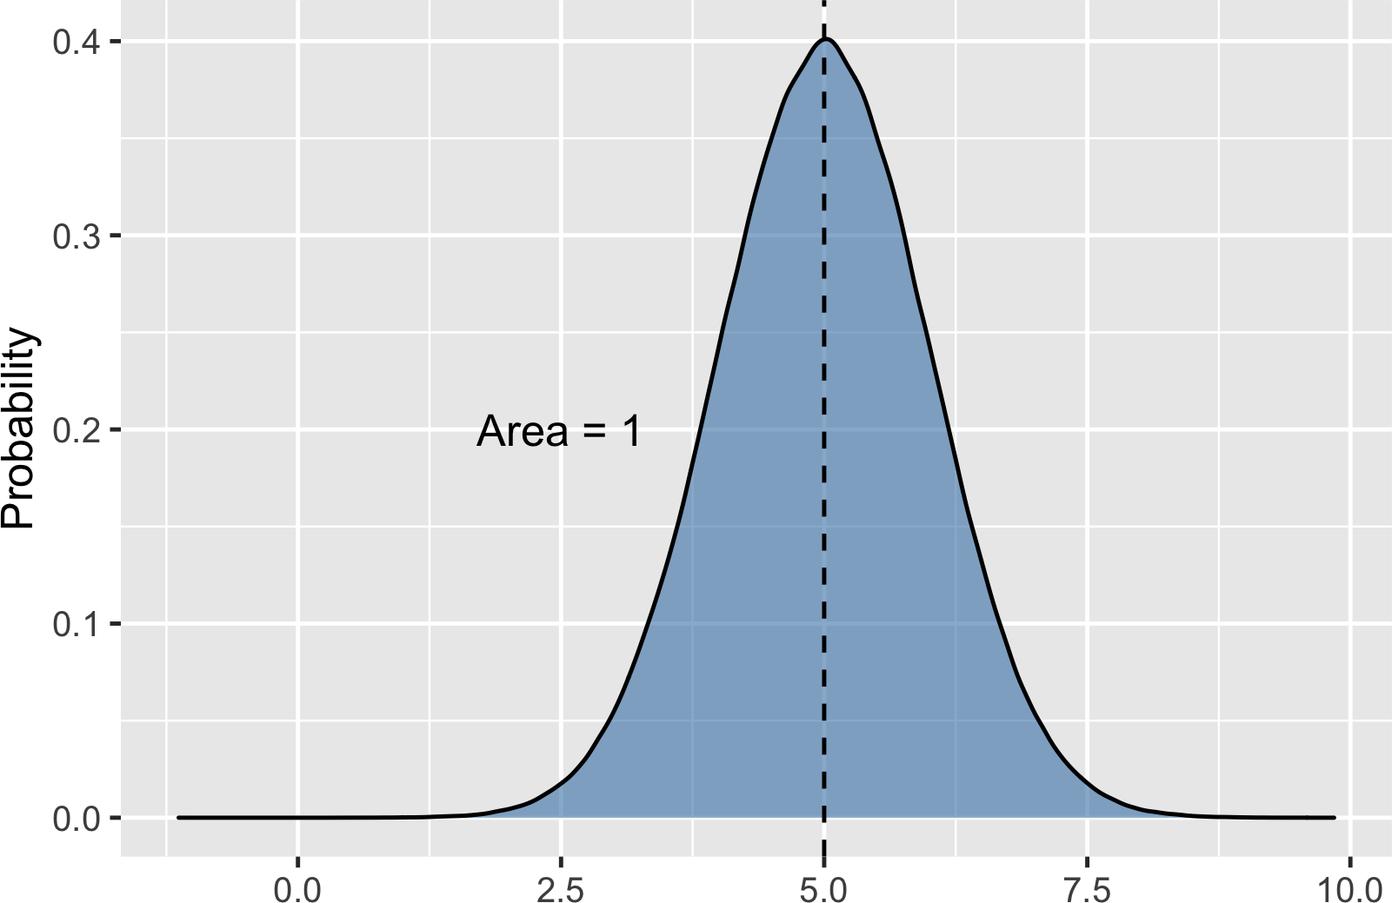
Area = 1

Slide 17
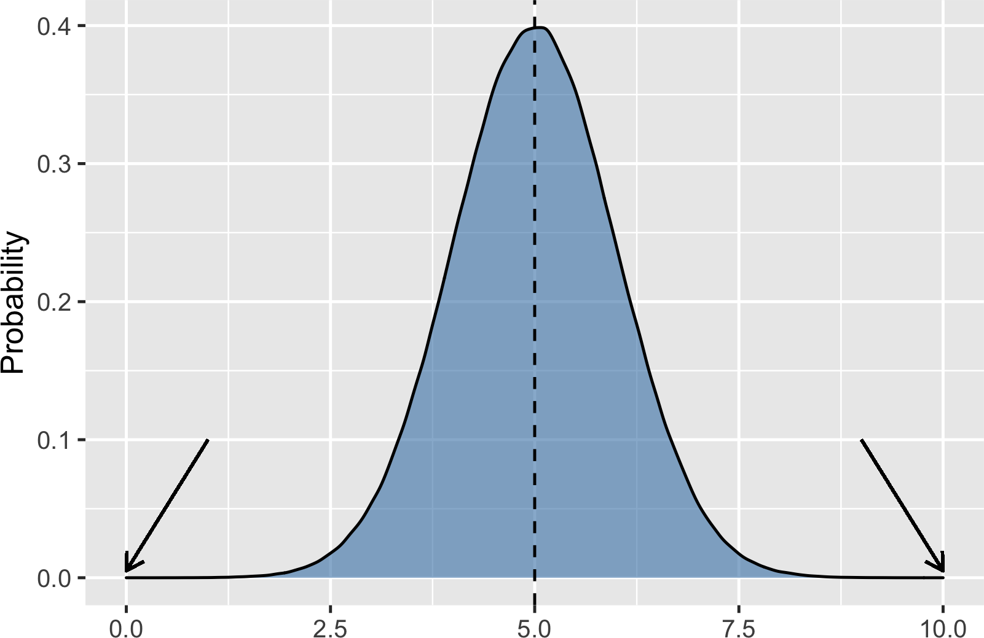
Curve never hits 0

Slide 18

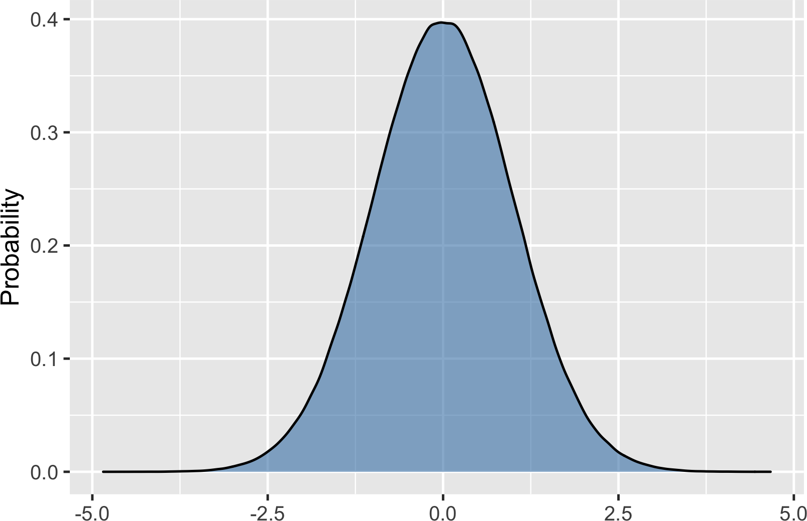
Described by mean and standard deviation
Mean = 20
Standard Deviation = 3
Mean = 0
Standard Deviation = 1

Slide 19
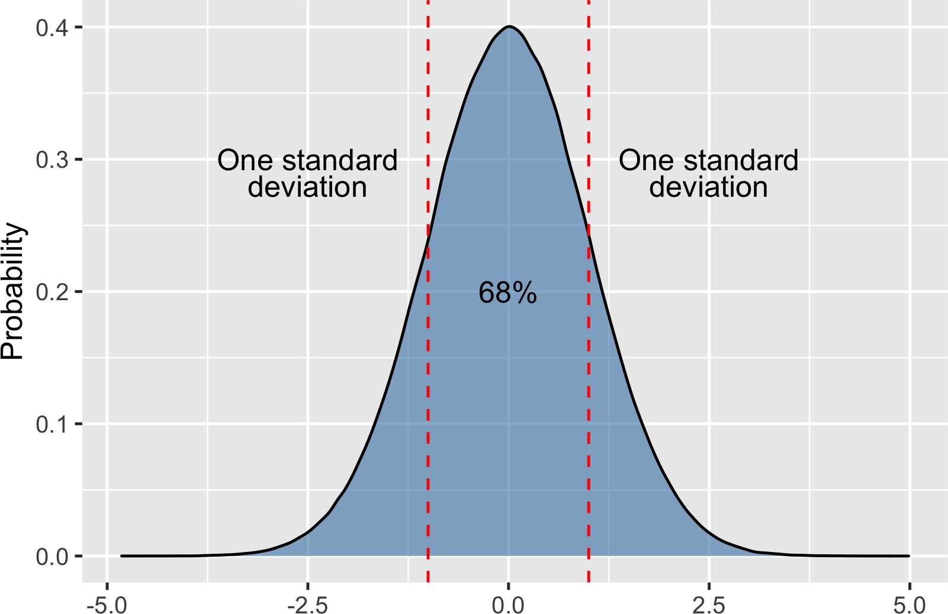
Areas under the normal distribution
68% falls within one standard deviation

Slide 20
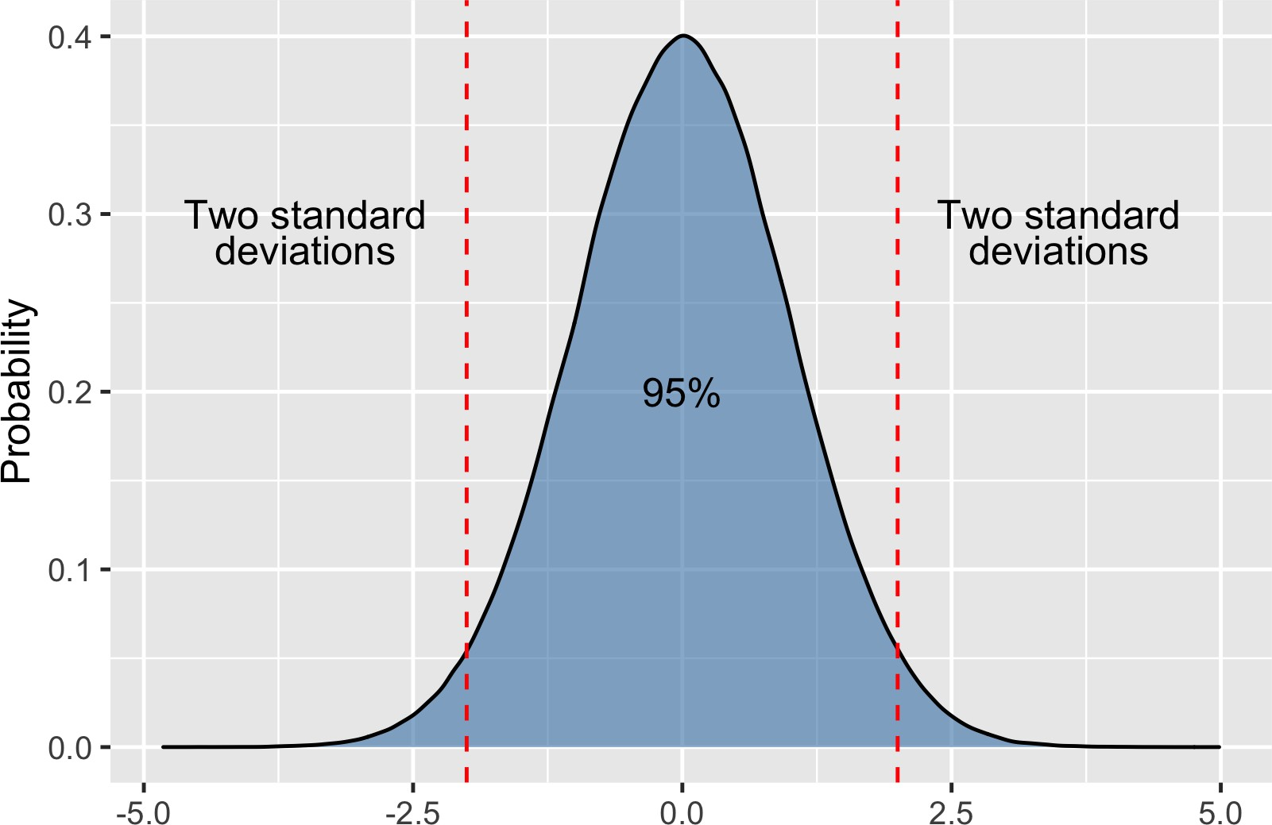
Areas under the normal distribution
95% falls within two standard deviations

Slide 21
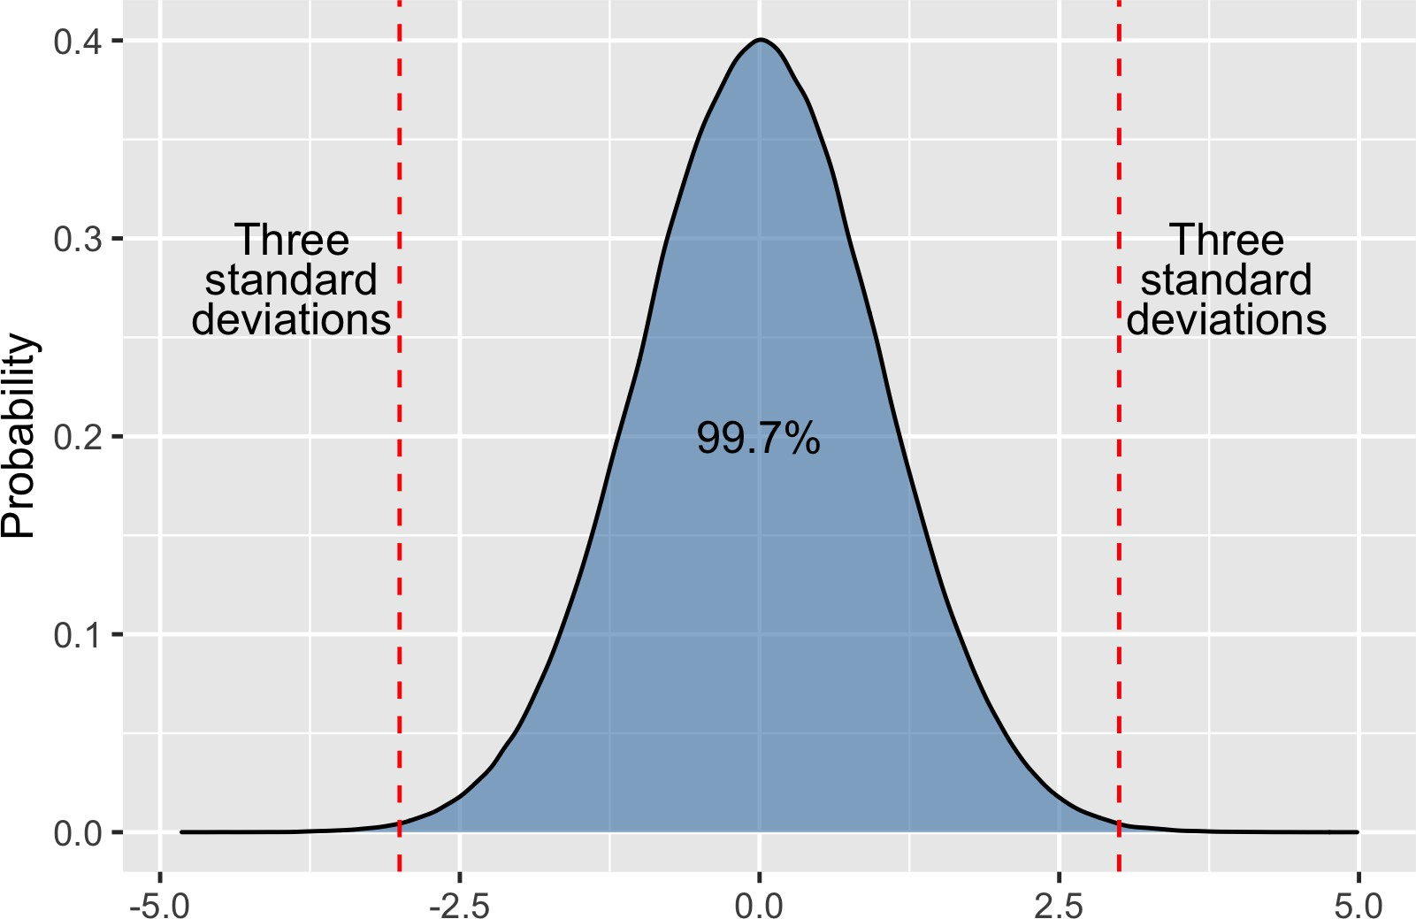
Areas under the normal distribution
99.7% falls within three standard deviations

Slide 22
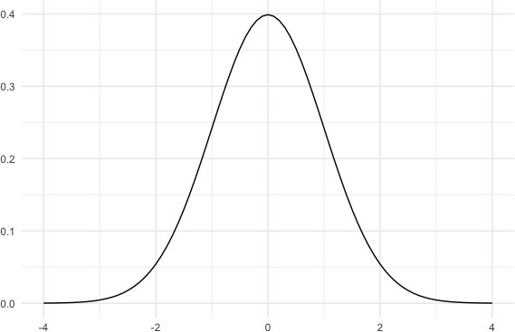
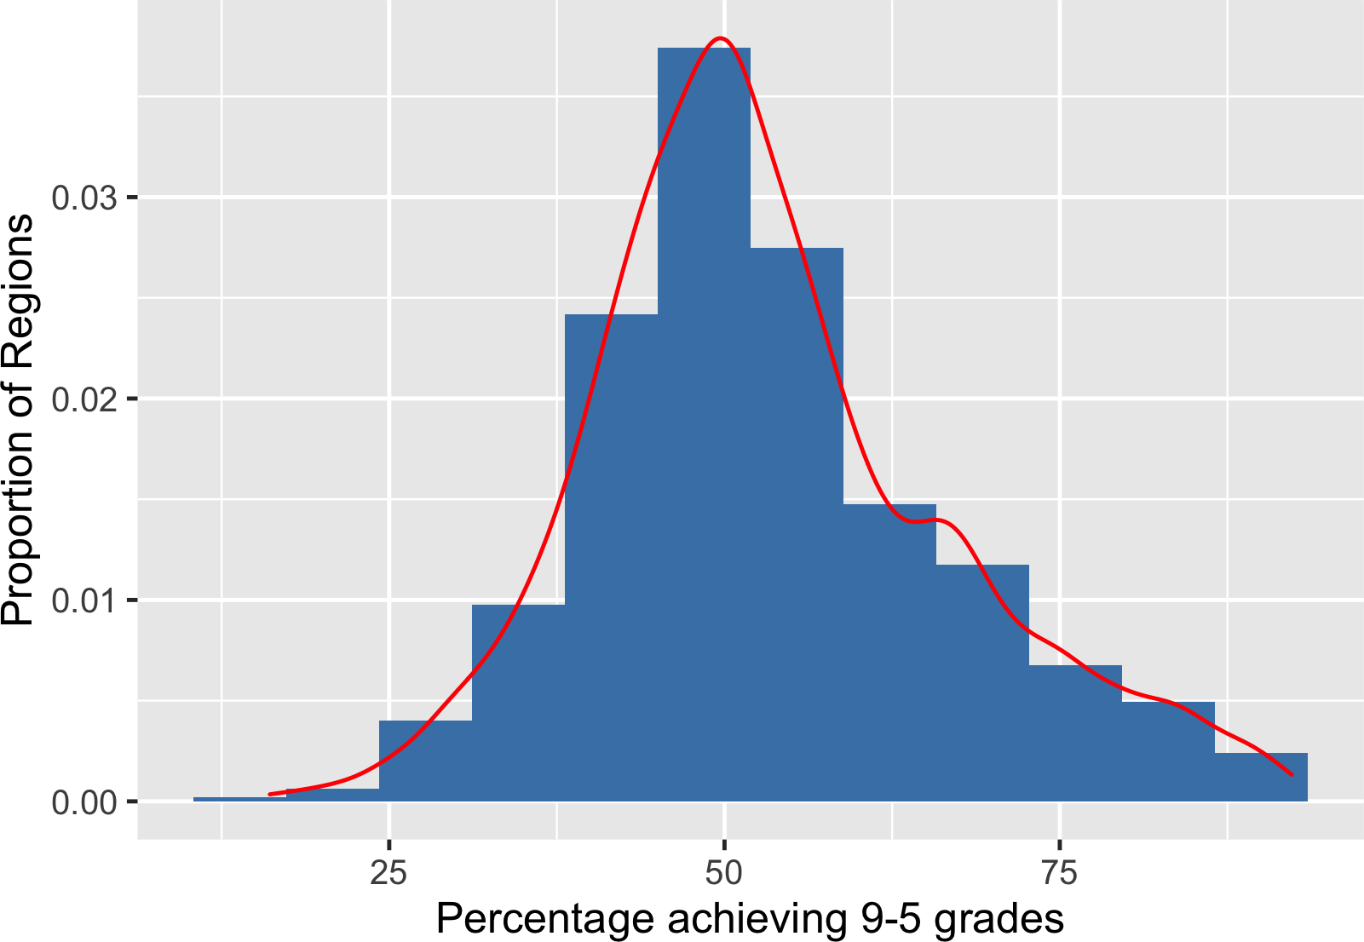
Why is the normal distribution important?
Lots of real-world data resembles a normal distribution.
A normal distribution is required for many statistical tests.
¹ Data source: https://data.gov.uk/dataset/ec1efd76-d6ad-4594-9b4d-944aa4170e63/gcse-english-and-maths- results-by-ethnicity

Slide 23
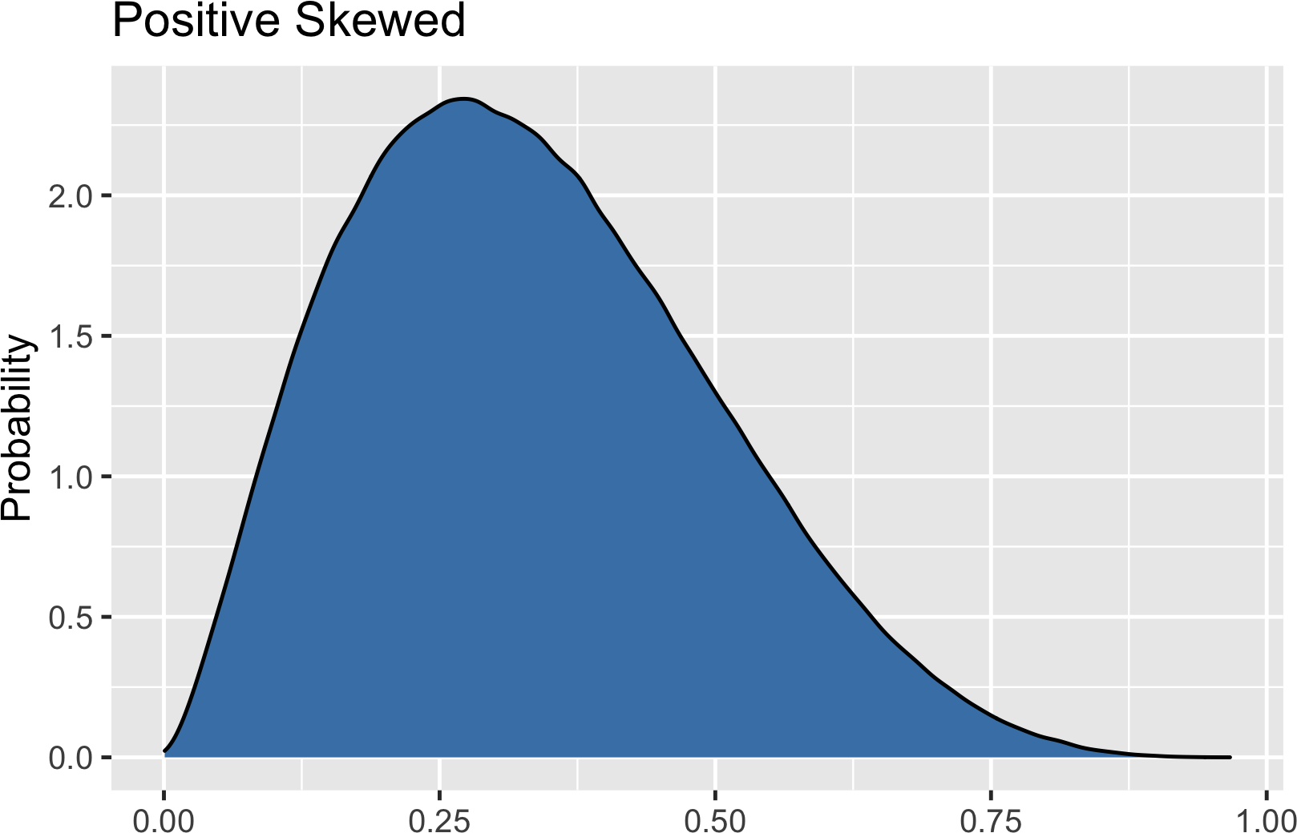
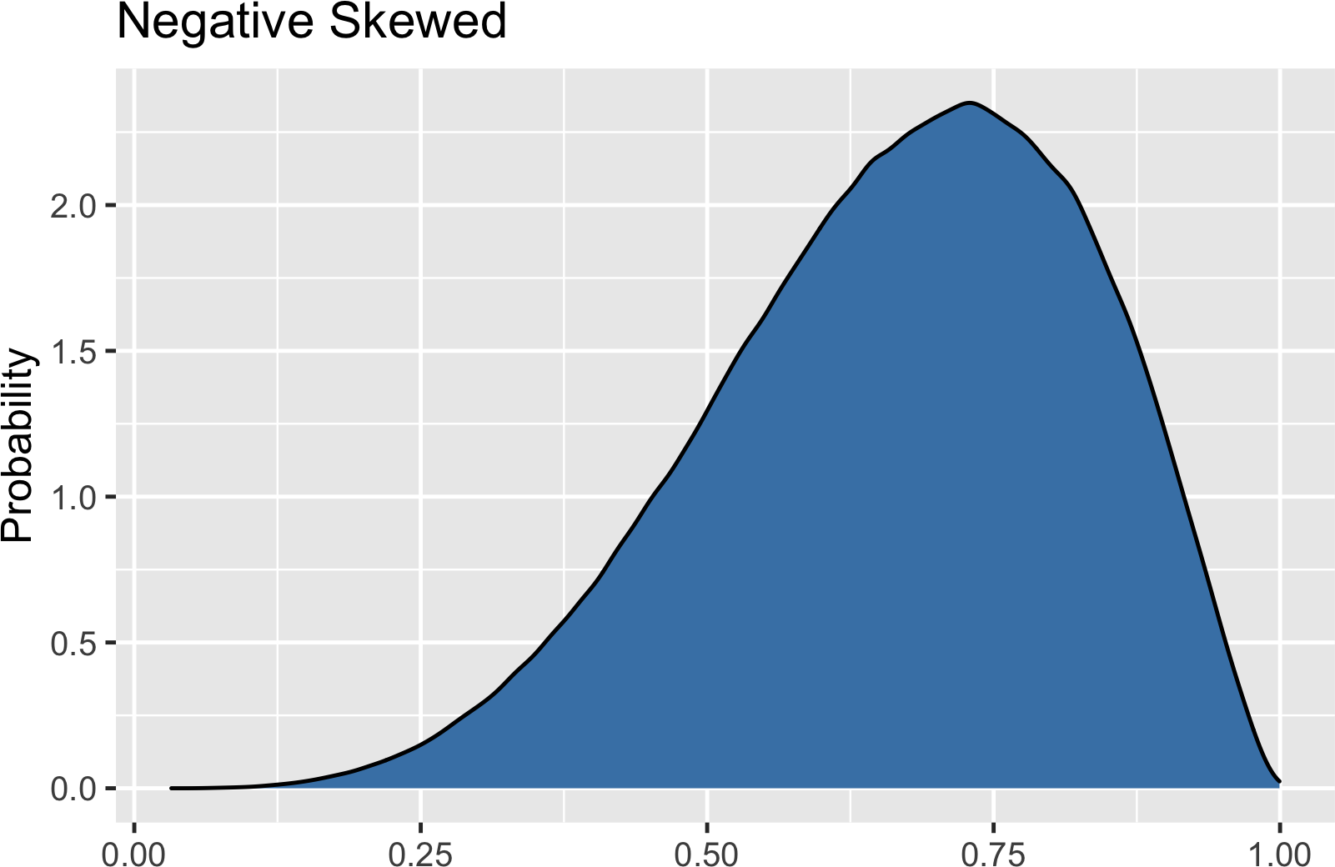
Skewness

Slide 24
Kurtosis
Kurtosis - a way of describing the occurrence of extreme values in a distribution. Three types of kurtosis

Slide 25
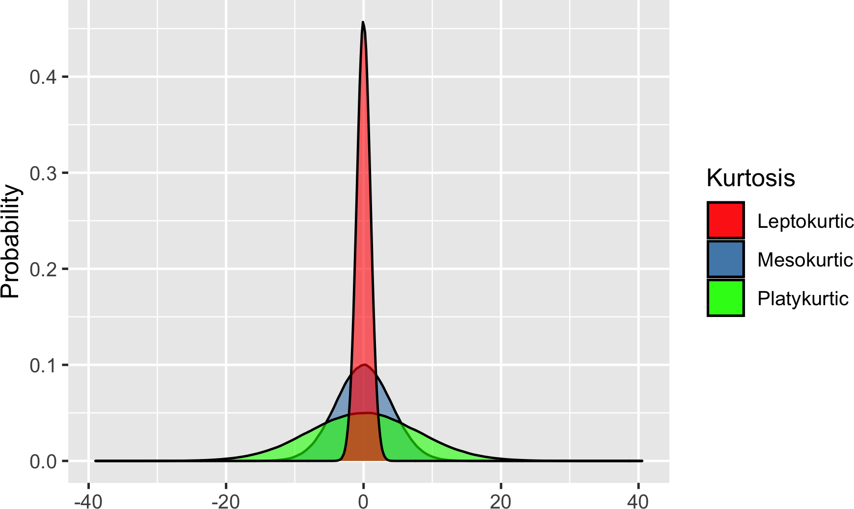
Kurtosis

Slide 26
The central limit theorem
I N T R O D U C T I O N TO STAT I ST I C S
George Boorman
Curriculum Manager, DataCamp

Slide 27

Rolling a die five times
Roll | Result
1 | 1
2 | 3
3 | 4
4 | 1
5 | 1
Mean(Results) = 2

Slide 28
Rolling a die five times
Roll | Result
1 | 4
2 | 4
3 | 5
4 | 3
5 | 6
Roll | Result
1 | 1
2 | 3
3 | 1
4 | 5
5 | 6
Mean(Results) = 4.4
Mean(Results) = 3.2

Slide 29
10 sets of five die rolls
Roll a die five times Record the mean Repeat 10 times
Set | Mean
1 | 3.8
2 | 4.0
3 | 3.8
4 | 3.6
5 | 3.2
6 | 4.8
7 | 2.6
8 | 3.0
9 | 2.6
10 | 2.0

Slide 30
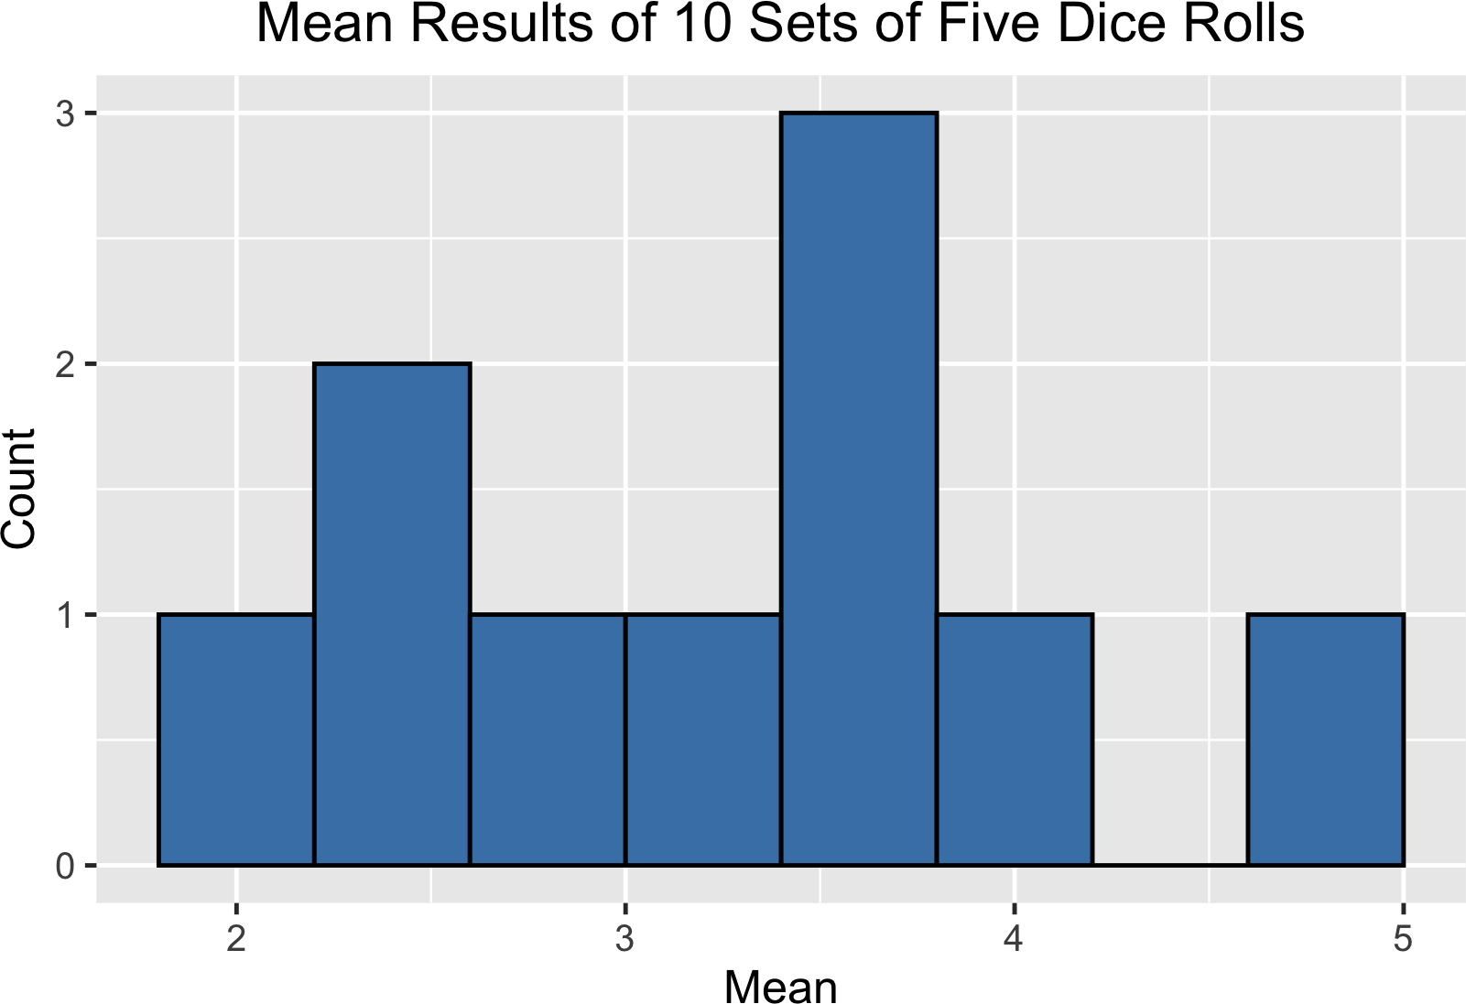
Sampling distributions
Sampling distribution of the sample mean

Slide 31
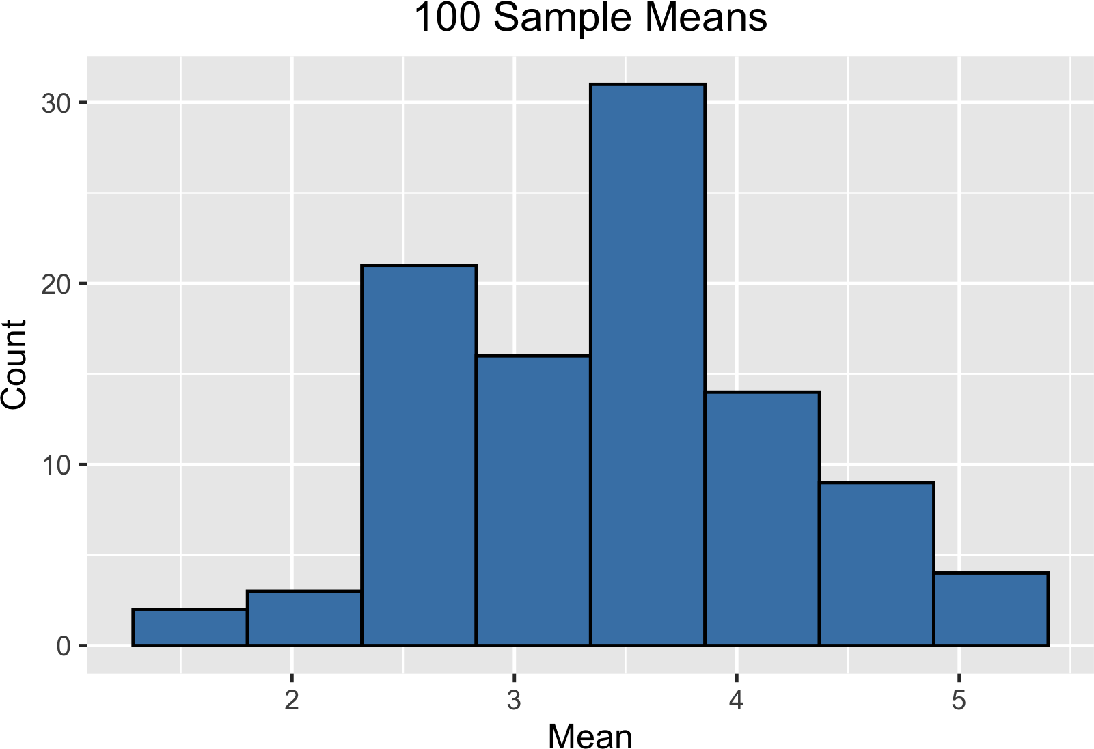
100 sample means

Slide 32
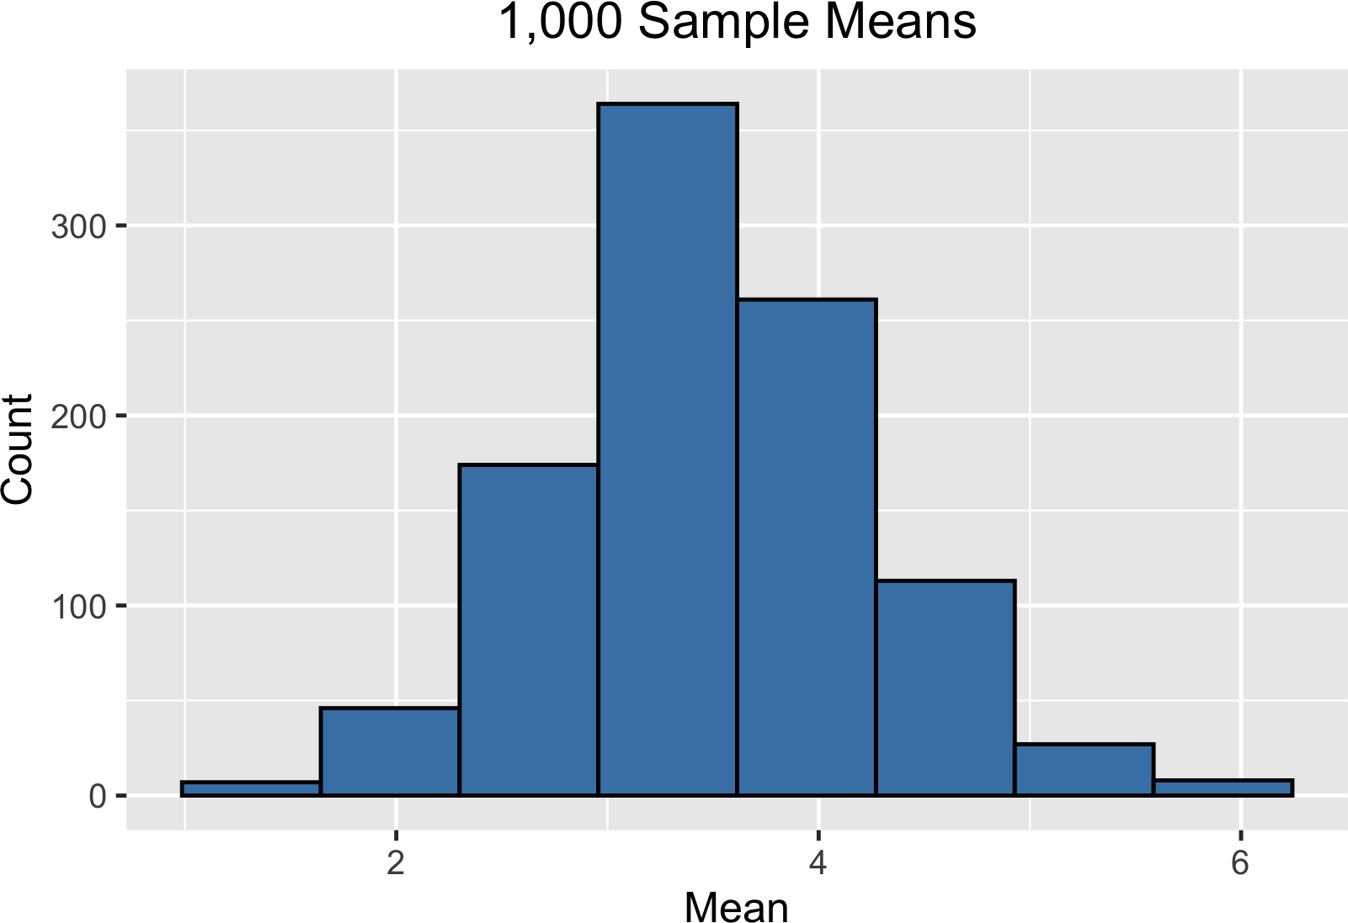
1000 sample means

Slide 33
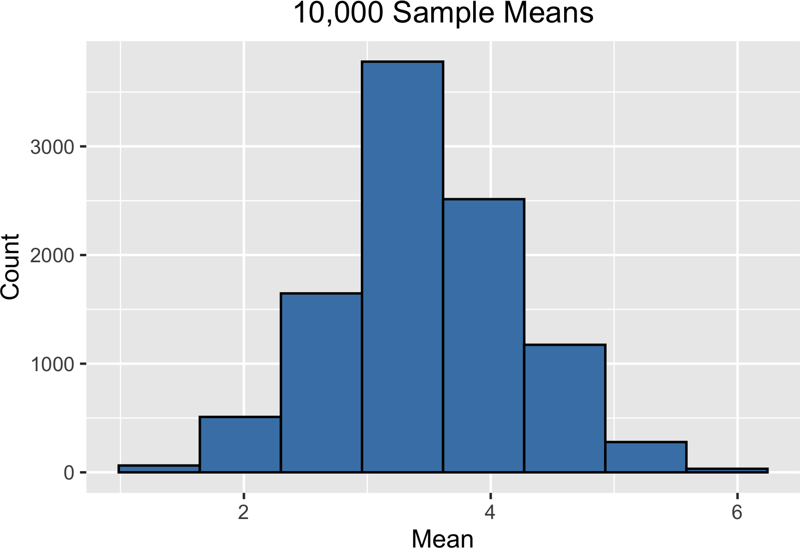
10000 sample means

Slide 34
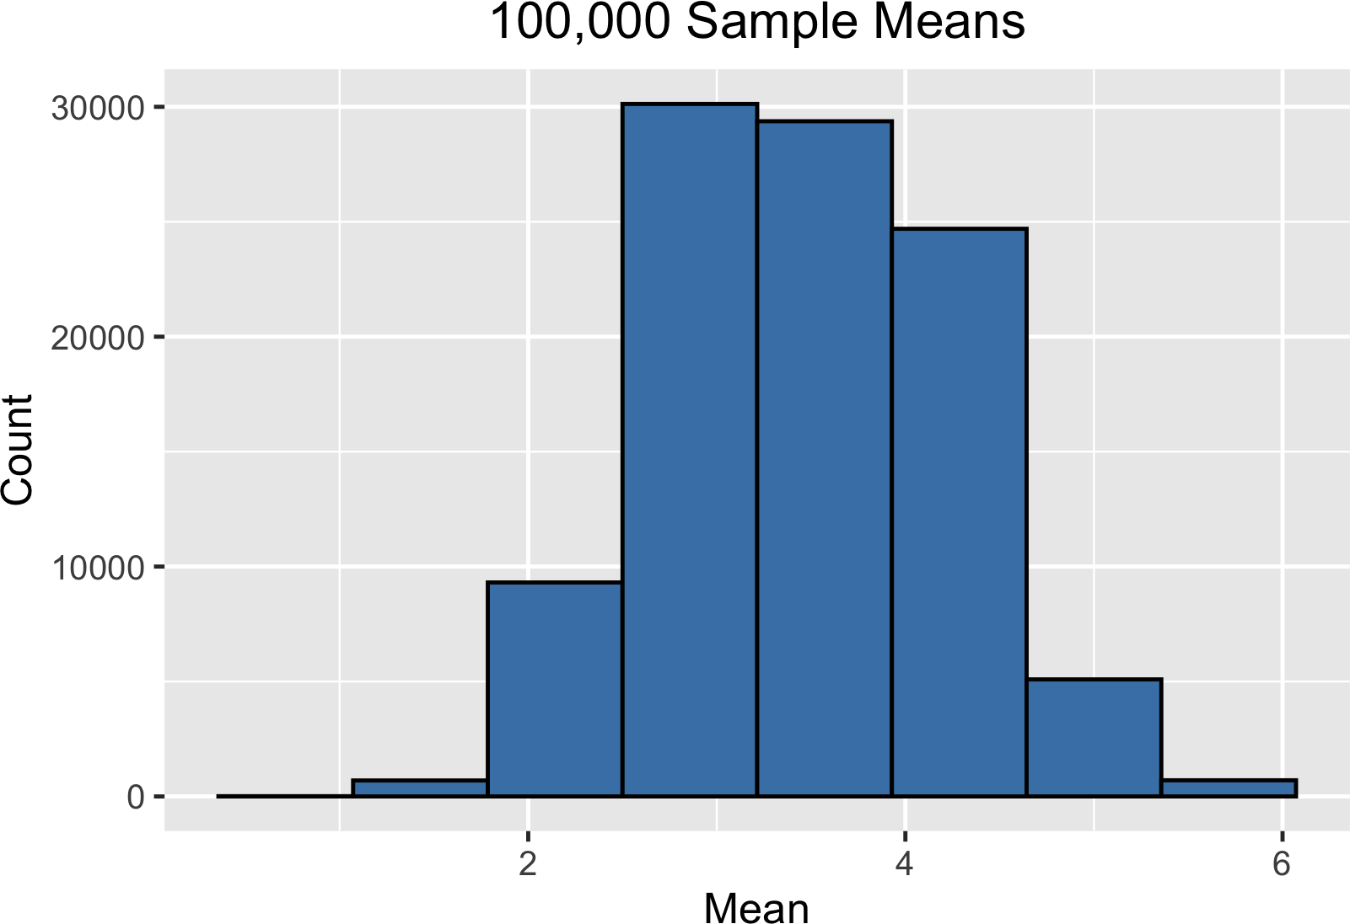
100000 sample means

Slide 35

One million sample means

Slide 36
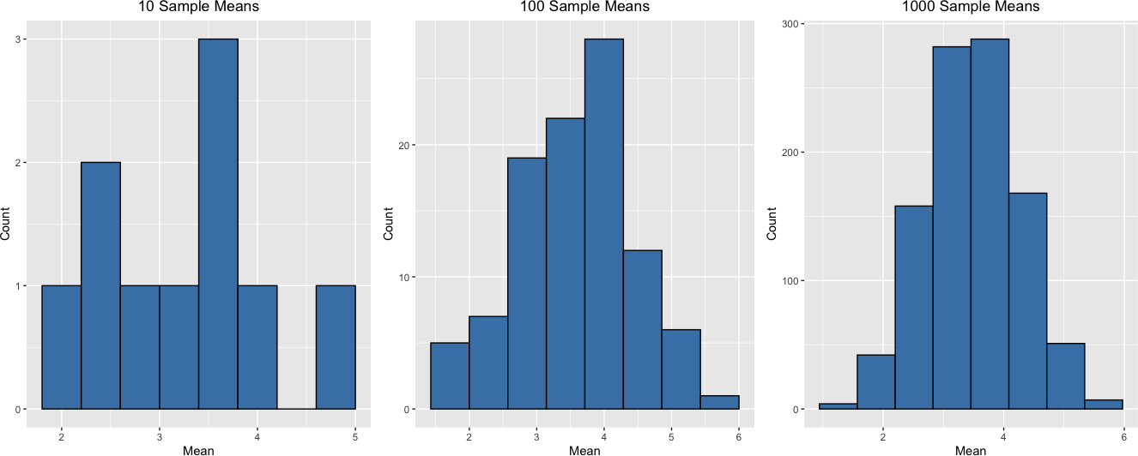
Central limit theorem
The sampling distribution of a statistic becomes closer to the normal distribution as the size of the sample increases.
* Samples should be random and independent

Slide 37
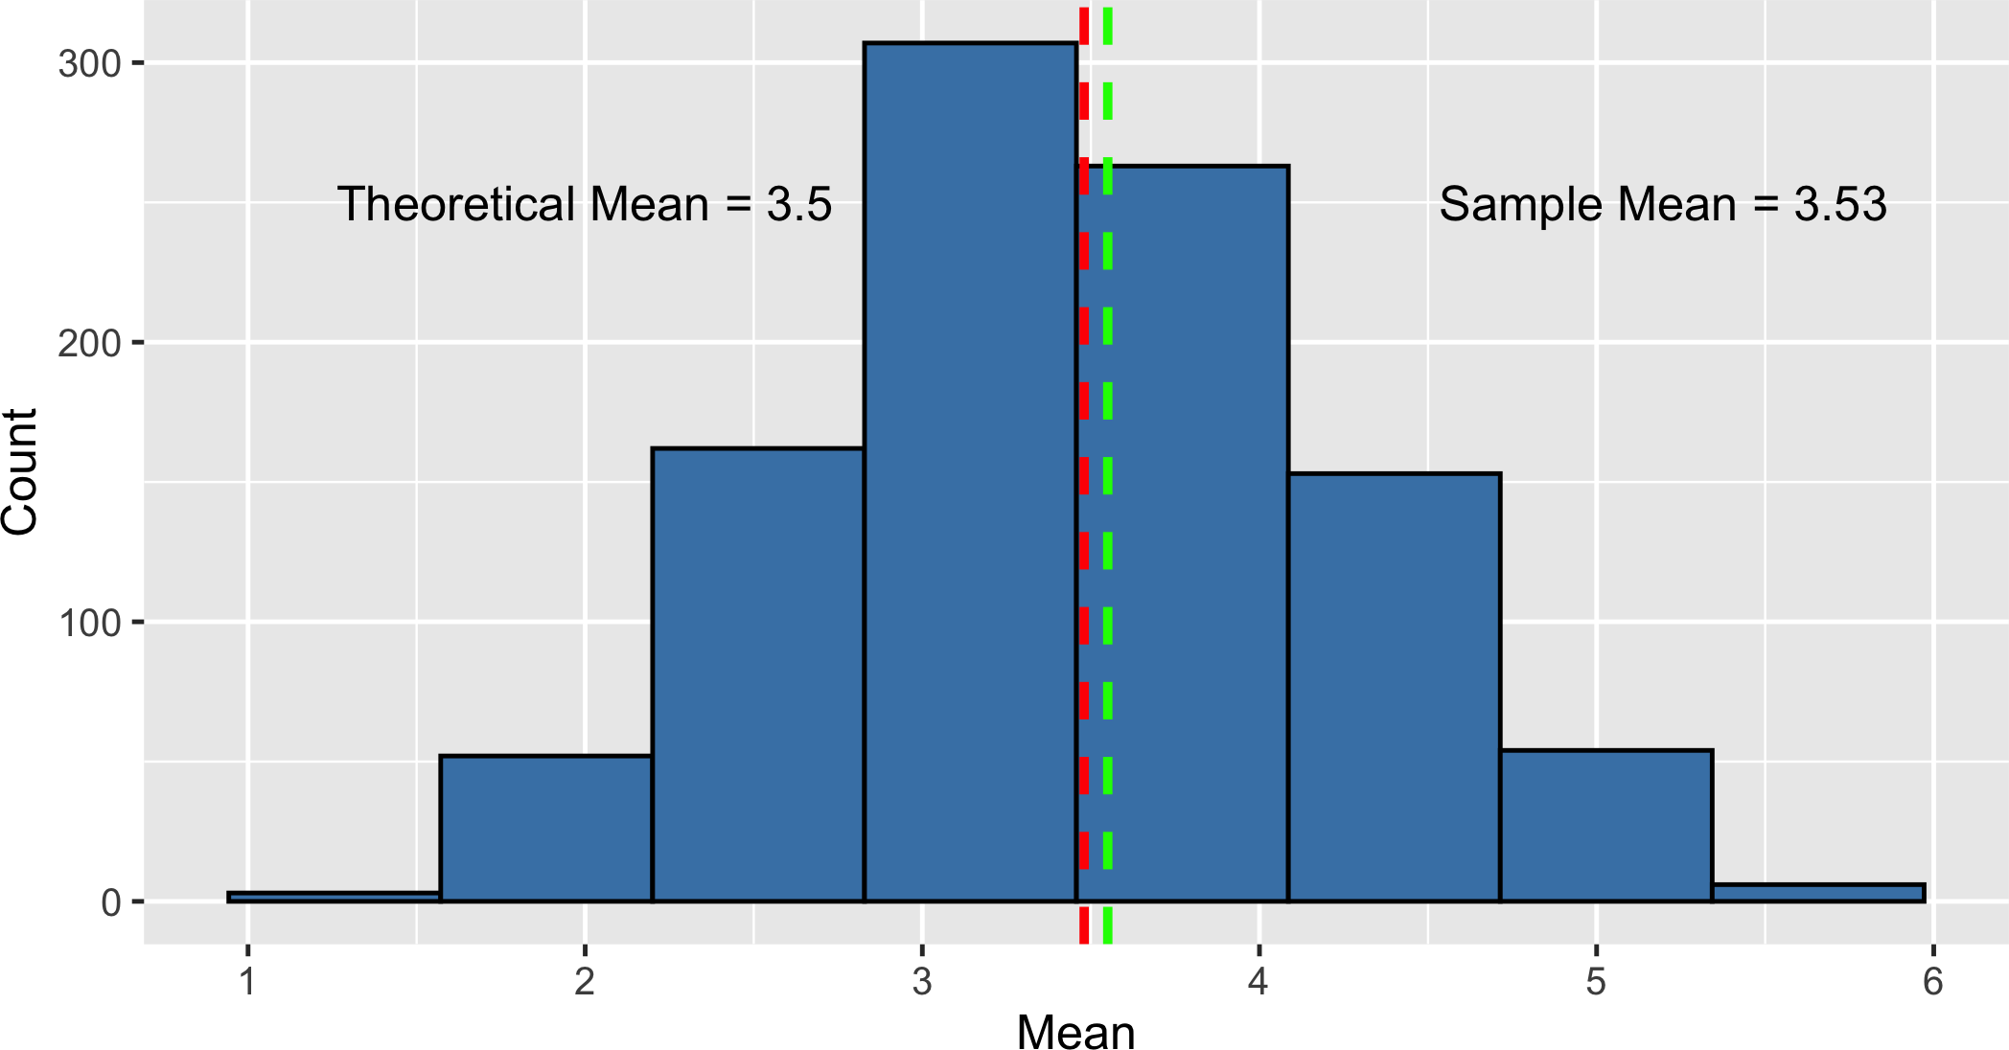
Mean of the sampling distribution

Slide 38
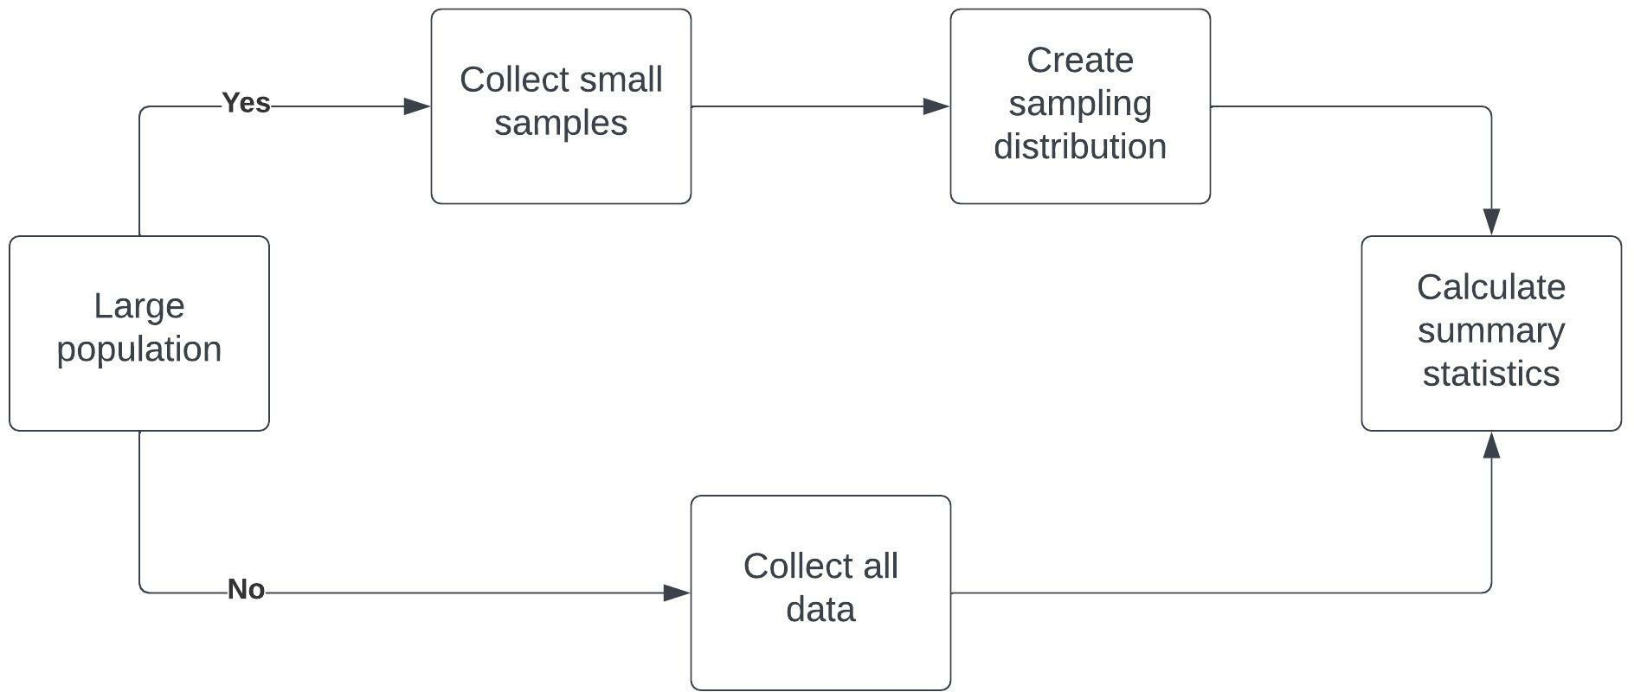
Benefits of the central limit theorem

Slide 39
The Poisson distribution
I N T R O D U C T I O N TO STAT I ST I C S
George Boorman
Curriculum Manager, DataCamp

Slide 40

Poisson processes
Average # of events in a period is known but the time or space between events is random
Poisson processes
Number of animals adopted from an animal shelter per week
Number of people arriving at a restaurant per hour
Number of website visits in a day
¹ Image credit: https://unsplash.com/@rodlong

Slide 41
Poisson distribution
Probability of some # of events occurring over a fixed period of time
Examples
Probability of at least five animals adopted from an animal shelter per week
Probability of 12 people arriving at a restaurant per hour Probability of less than 200 visits to a website in a day

Slide 42
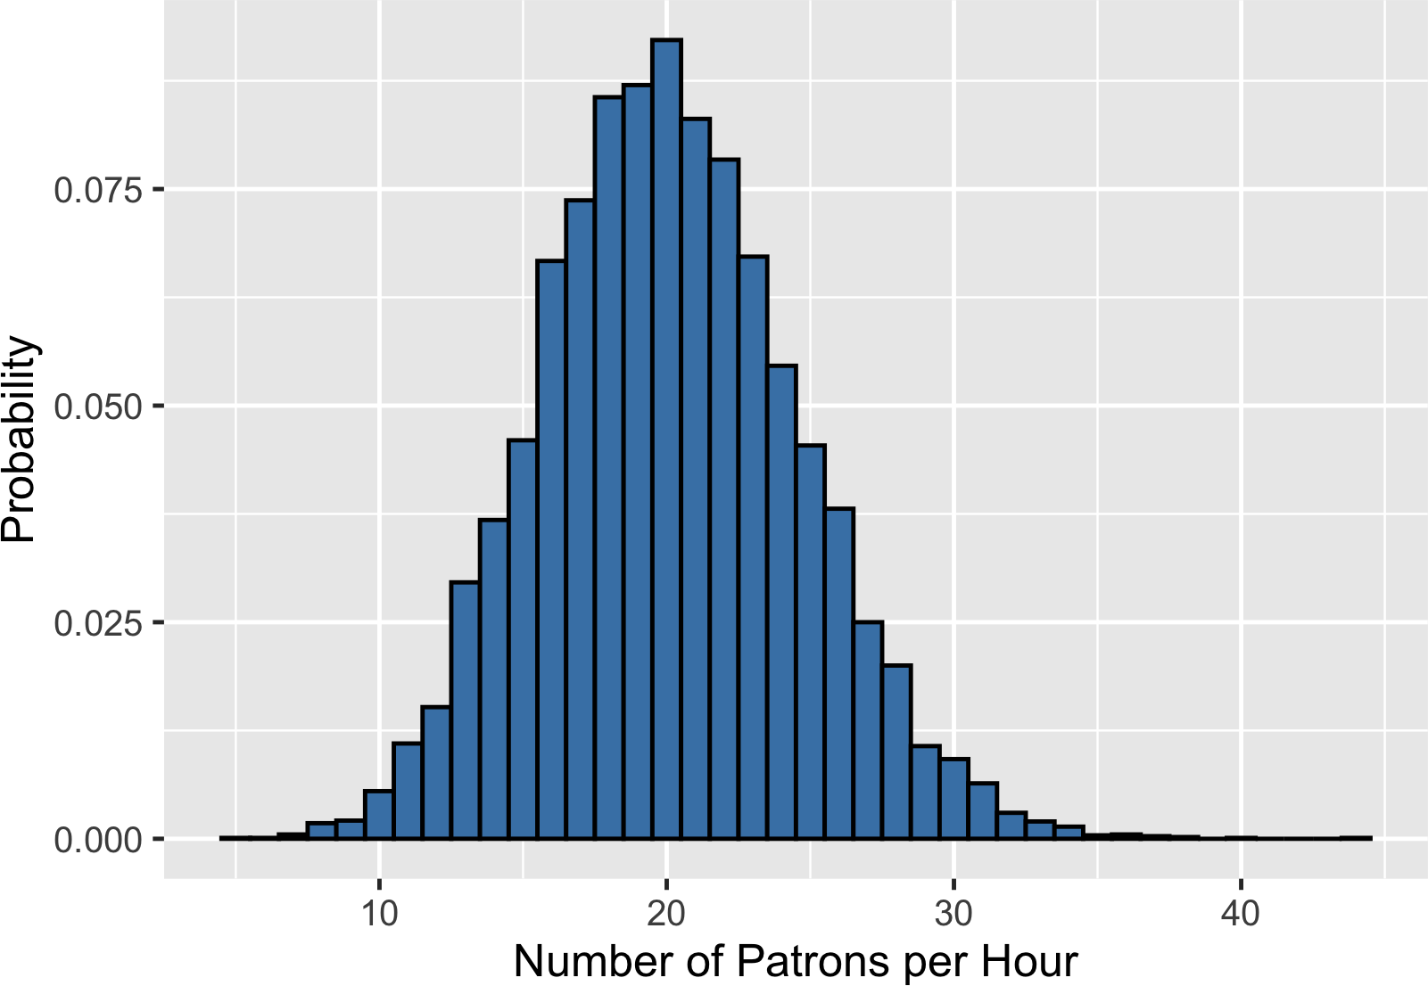
Lambda (λ)
λ = average number of events per time interval Average number of patrons per hour = 20
λ = the expected value of the distribution!

Slide 43
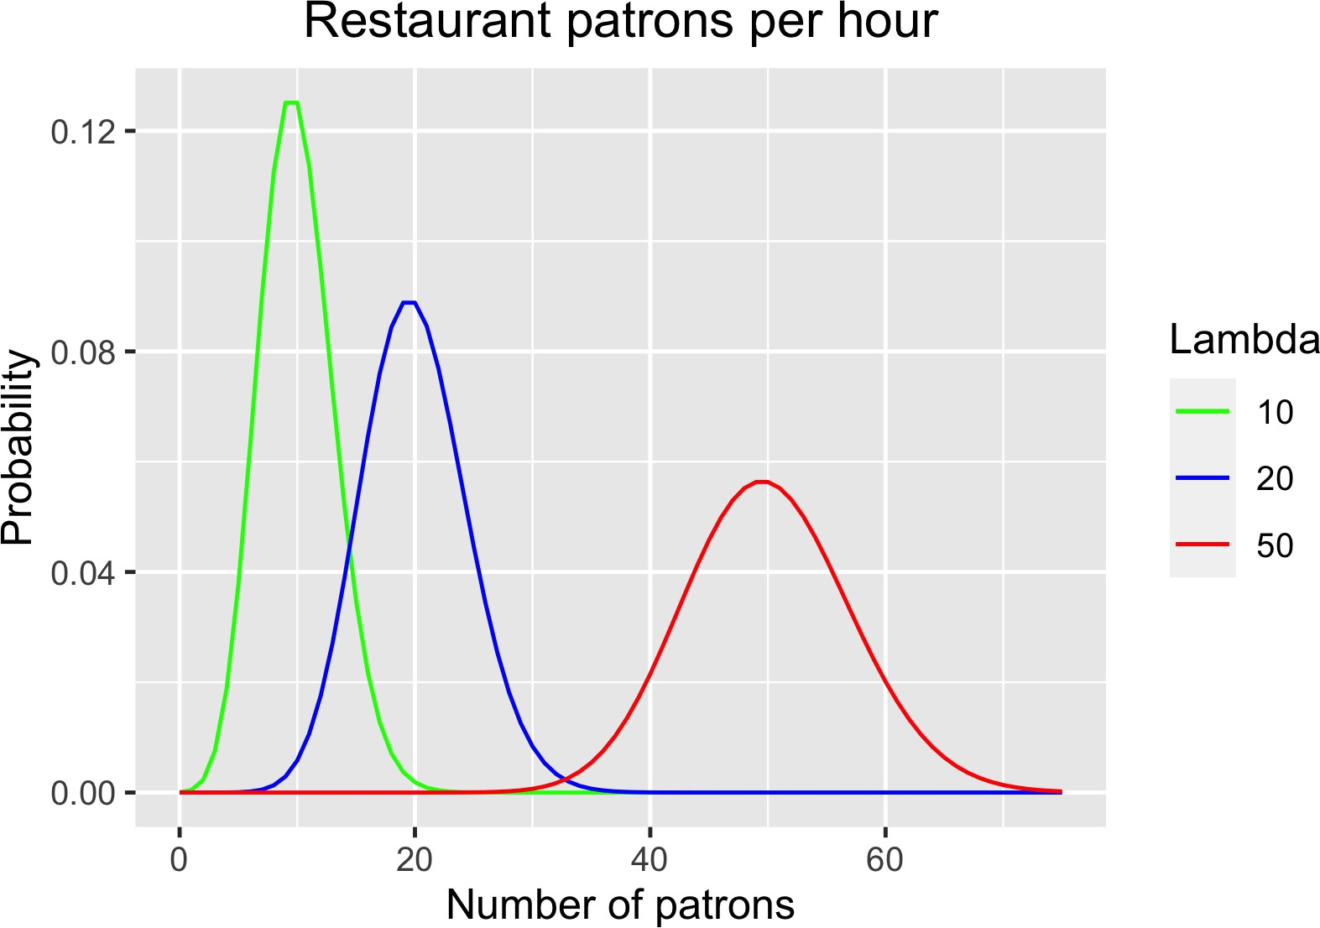
Lambda is the distribution's peak

Slide 44
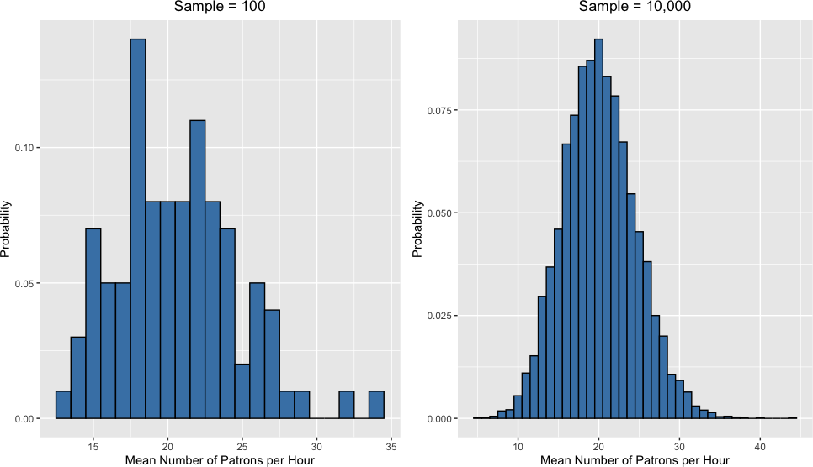
Central limit theorem still applies!

Slide 45
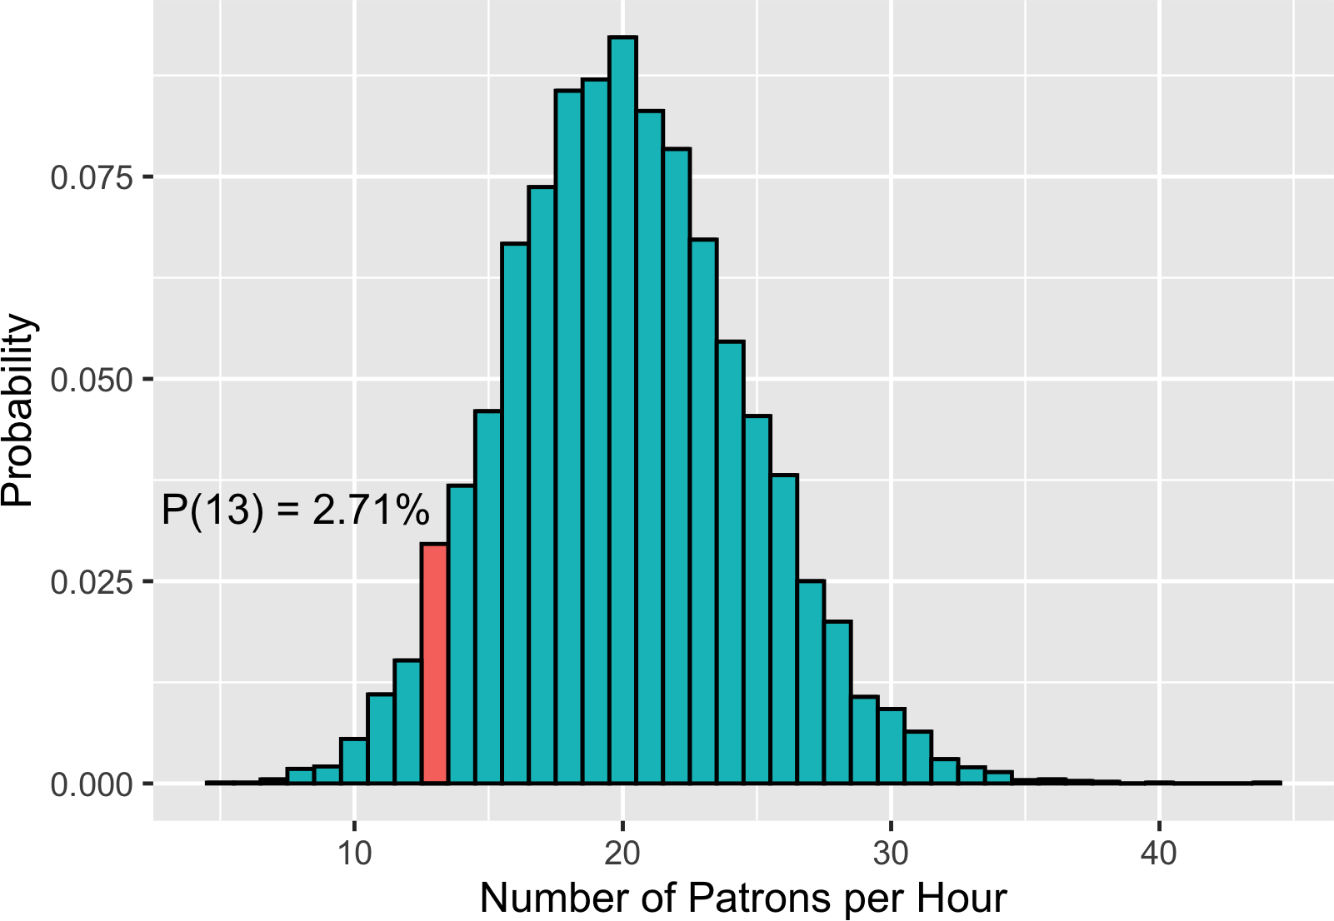
Probability of 13 patrons in an hour

Slide 46
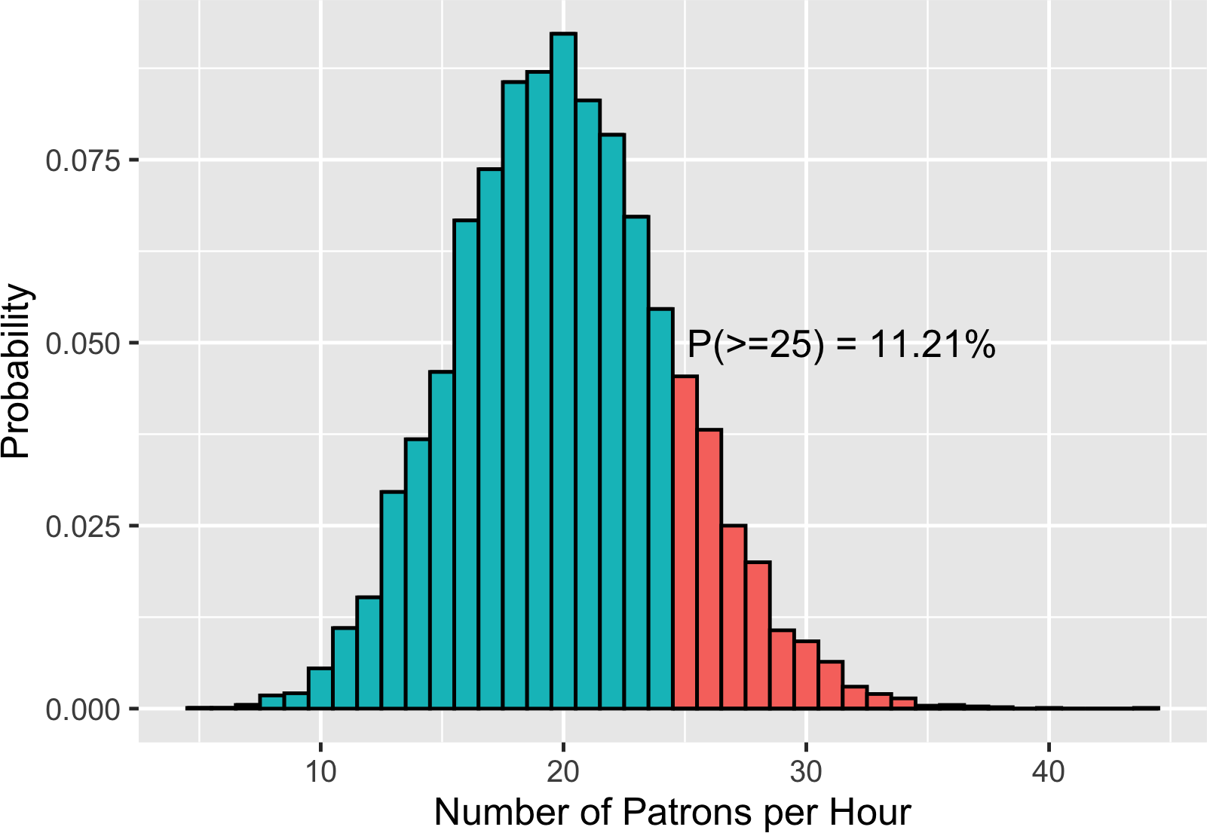
Probability of 25 or more patrons

